Slide 1

Superstore sales POWER-BI Dashboard
-Siddhi Tarmale
This Photo by Unknown Author is licensed under CC BY

Slide 2

The project includes:
- Power Bi Project Objective
- Import Data in Power BI
- Data Cleaning & Processing in Power BI
- Power Query Editor
- DAX in Power BI
- Measures and Calculations in Power BI
- Create New Columns and Tables in Power BI
- Advanced Charts and Maps in Power BI
- Filters and Slicers in Power BI
- Zoom in Charts in Power BI
- Dashboard Design
- Forecasting in Power BI
- Power BI Sales Forecast
- Insights from Dashboard

Slide 3

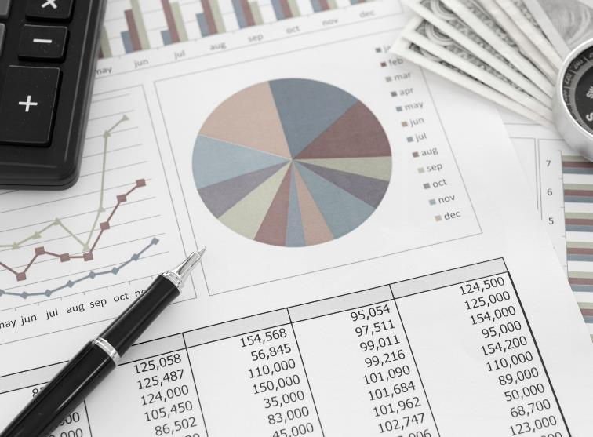
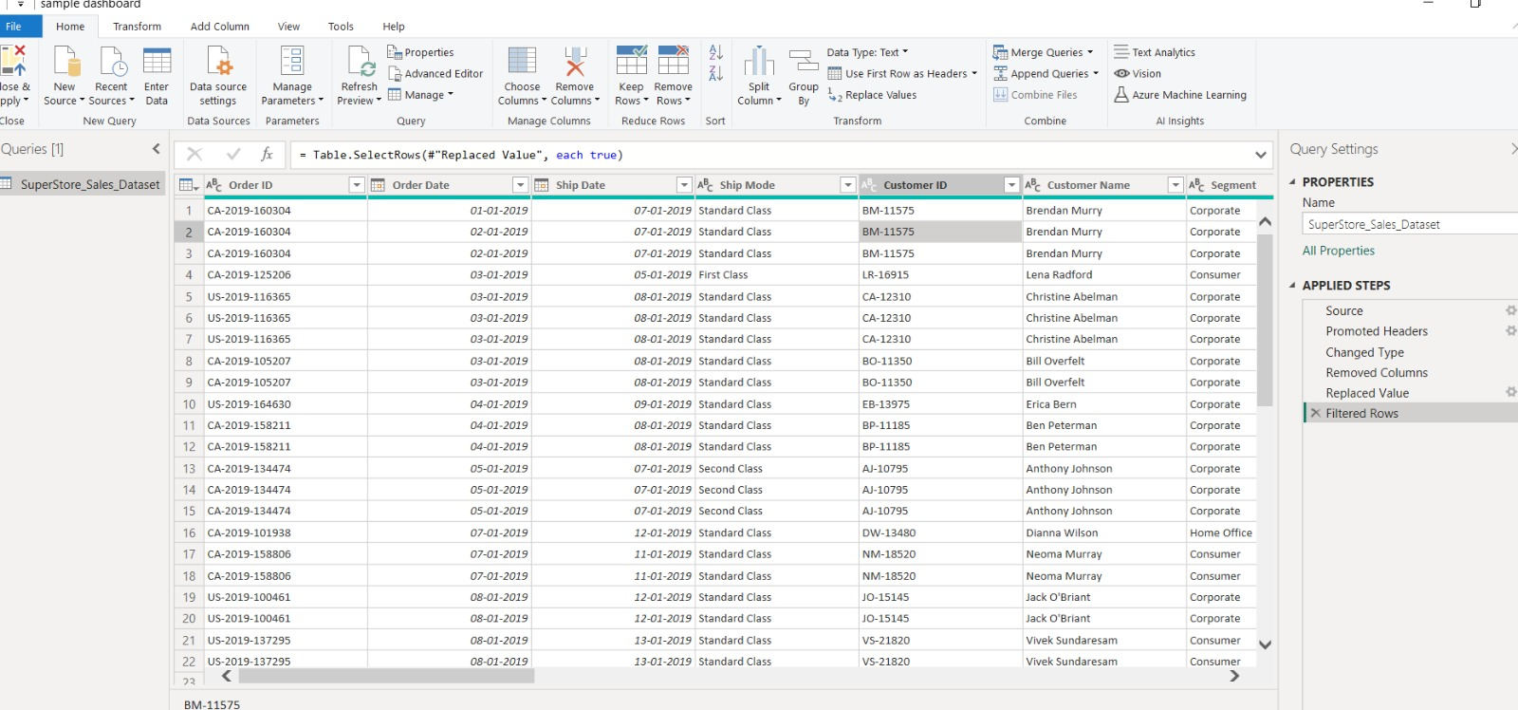
Power Bi Project Objective
To contribute to the success of a business by utilizing data analysis techniques specially focusing On time series analysis to provide valuable insight & accurate sales forecasting.
Dataset - https://rb.gy/6l7bl

Slide 4
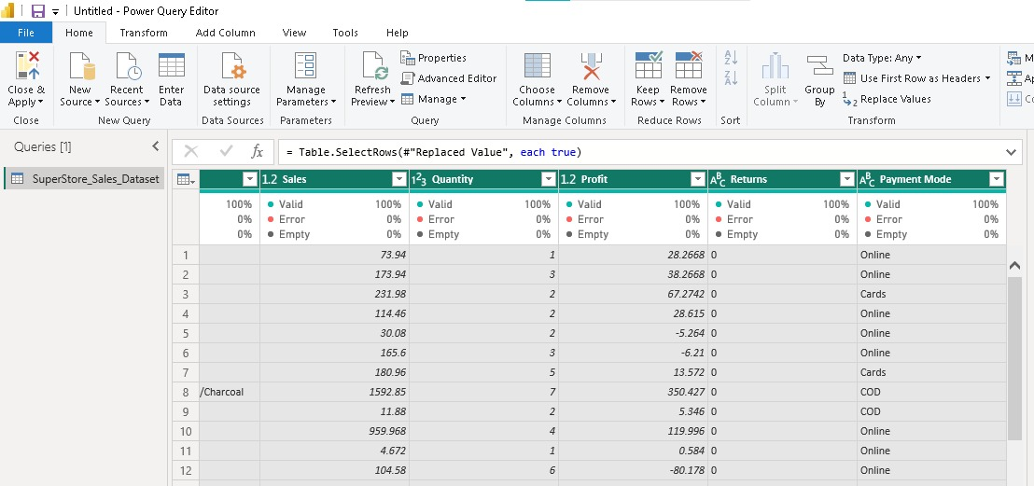
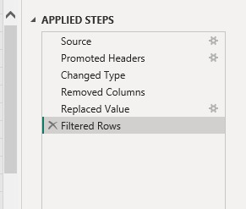
Import Data in Power BI
We can Import dataset in any format like SQL,CSV file,xls,text,Json etc
Data Cleaning & Processing in Power BI
Transform the data file in the power query editor
Change the datatype , detect null/empty set and modify
Remove duplicates, blank spaces
Replace #N/A value with zero in return column.

Slide 5
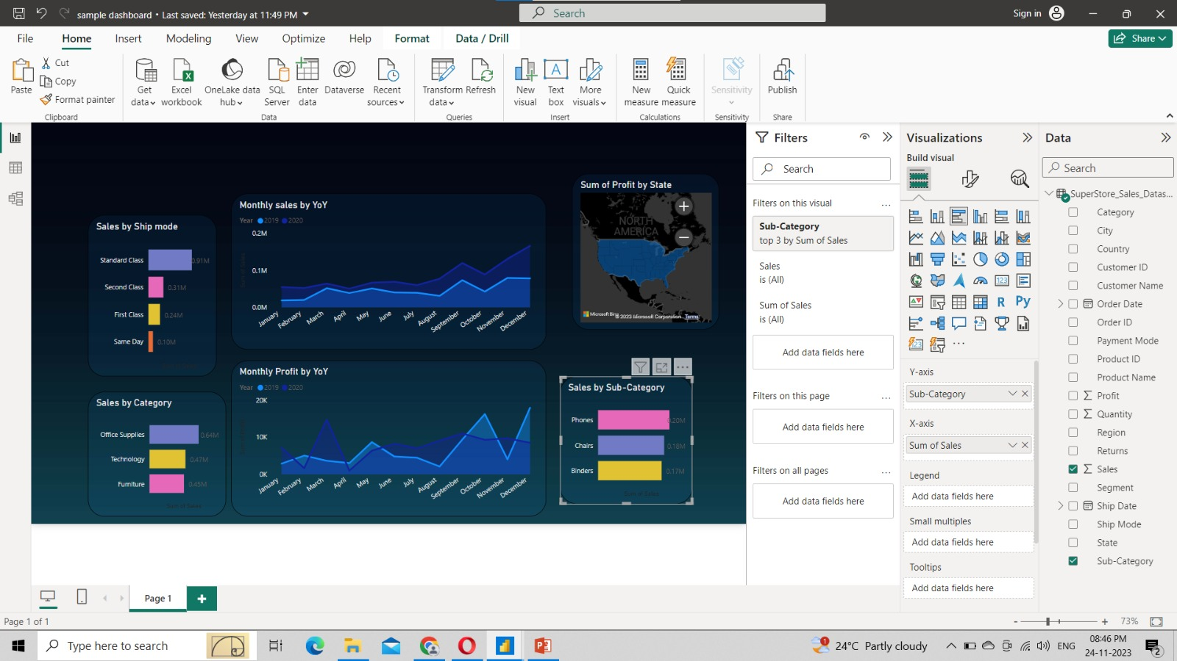
Dashboard creation:
Make clustered chart of categeory v/s sales with different effects.
likewiseeg create Map chart, Area chart, Donut chart etc.
Change canvas backgraound to blue gradient for effective visualization.
Change effects of chart :colour,text,transparency,border
Make tooltips on to see the details.
Create multiple charts by crt+c & crt+v.
Rename the title according to Map.
Make trend axis to compare sales.
Used the bubble visual to showcase
sales for better clarity.

Slide 6
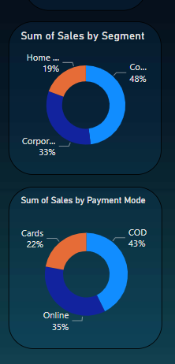
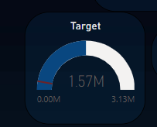
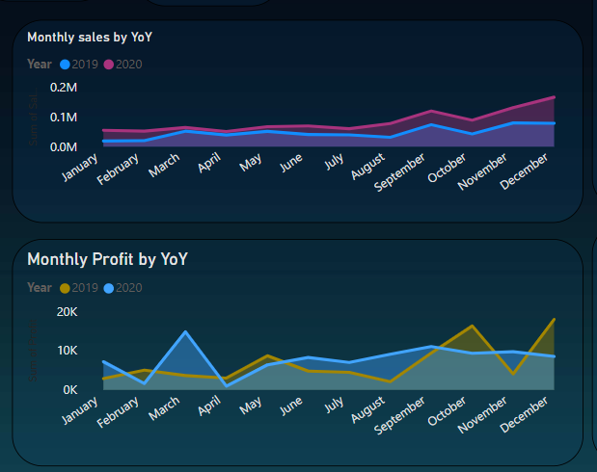
Gauge chart:
Gauge charts give you a way to quickly see how well a given metric is performing against a target goal.
The gauge line (or needle) represents the goal or target value. The shading represents the progress toward
Donut chart:
Donut charts are used to visualize a section of whole rather than comparing individual values
It compare values from a single dimention.
I have made charts on basis of customer segment & payment mode
Area charts
Area charts emphasize the magnitude of change over time, and can be used to draw attention to the total value across a trend.
For example, here data that represents profit over time can be plotted in an area chart to emphasize the total profit. Likewise for the sales the chart is shown by year basis respectively.
Advanced charts

Slide 7
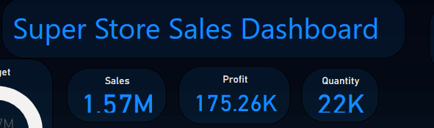
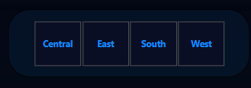
Slicers,KPIs
Slicer
Slicer is the type of fliter used to customize analysis of the report.
I have made the region wise slicer to filter out data.
KPIs –Key performance indicator
We can show the sum,avg,max,min etc of important data using cards.
I have displayed sales,profit, quantity and avg delivery days as KPIs
We can customize the values as whole/decimal no.

Slide 8
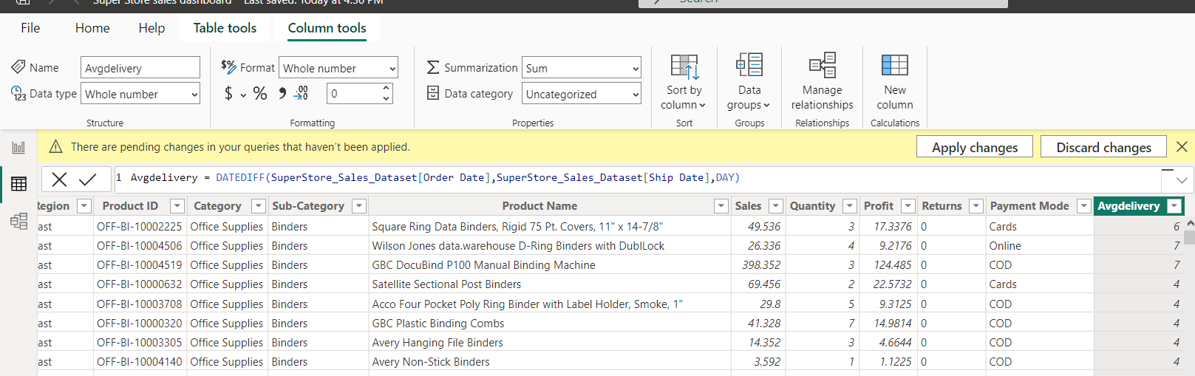
DAX Query in Power BI
For the Detailed Analysis expression we have created new column to find out Average Delivery Days.
For that write query in table view & refresh the Report View.
DAX Query = Avgdelivery = DATEDIFF(SuperStore_Sales_Dataset[Order Date],SuperStore_Sales_Dataset[Ship Date],DAY)

Slide 9
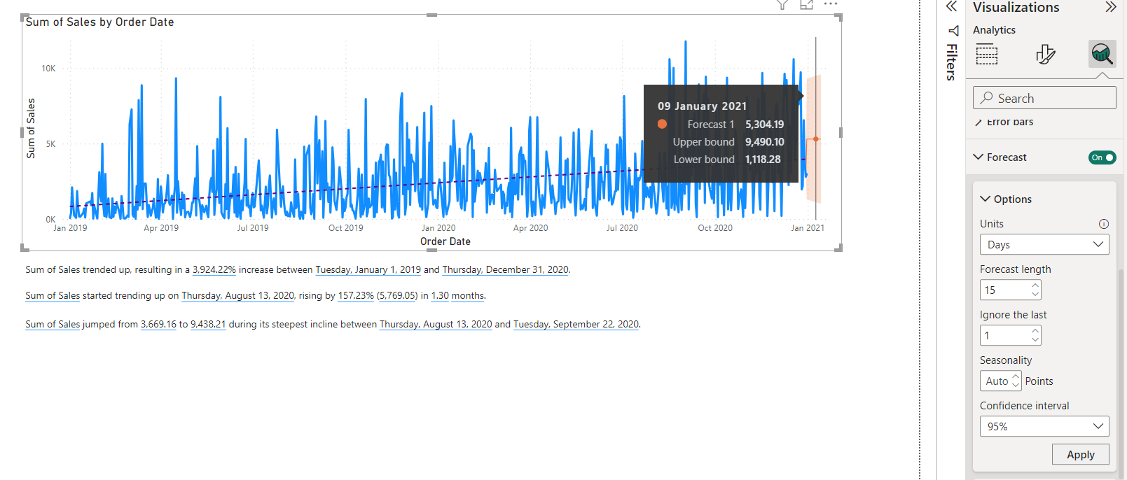
Power BI sales forecasting
Sales forecasting can be shown by line chart for the days, months &years format also.
I have done forecasting of sales by order date for next 15 days.
We can summarize the forecasting otherwise can shown in table format also.
Depending the confidence the forecasting will change accordingly.
Eg. For 09 Jan 2021 : max sale can be upper bound value and min sale can be lower bound value respectively.

Slide 10
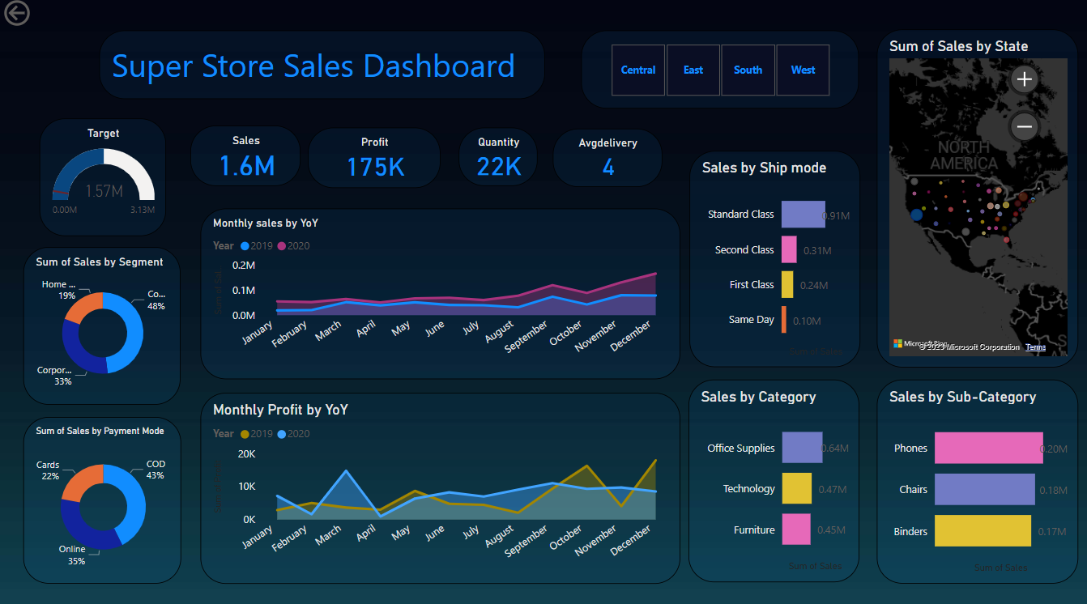
Dashboard Design

Slide 11
Insight from dashboard
Profit is high in march 2020 than march 2019 and its increases at the end of year.
Though there is low sales in October month but profit is high.
Standard class ship mode is preferred largely over customers.
There is high sales for the phones in subcategory level and office supplies in category level respectively.
Lowest payment mode is through cards so we can run credit cards offer to increase that segment sales.
Consumers are contributed for the highest sale than the home offices & cooperates. To increase their have We should run the sales offer specially on home offices & cooperates products.

Slide 12
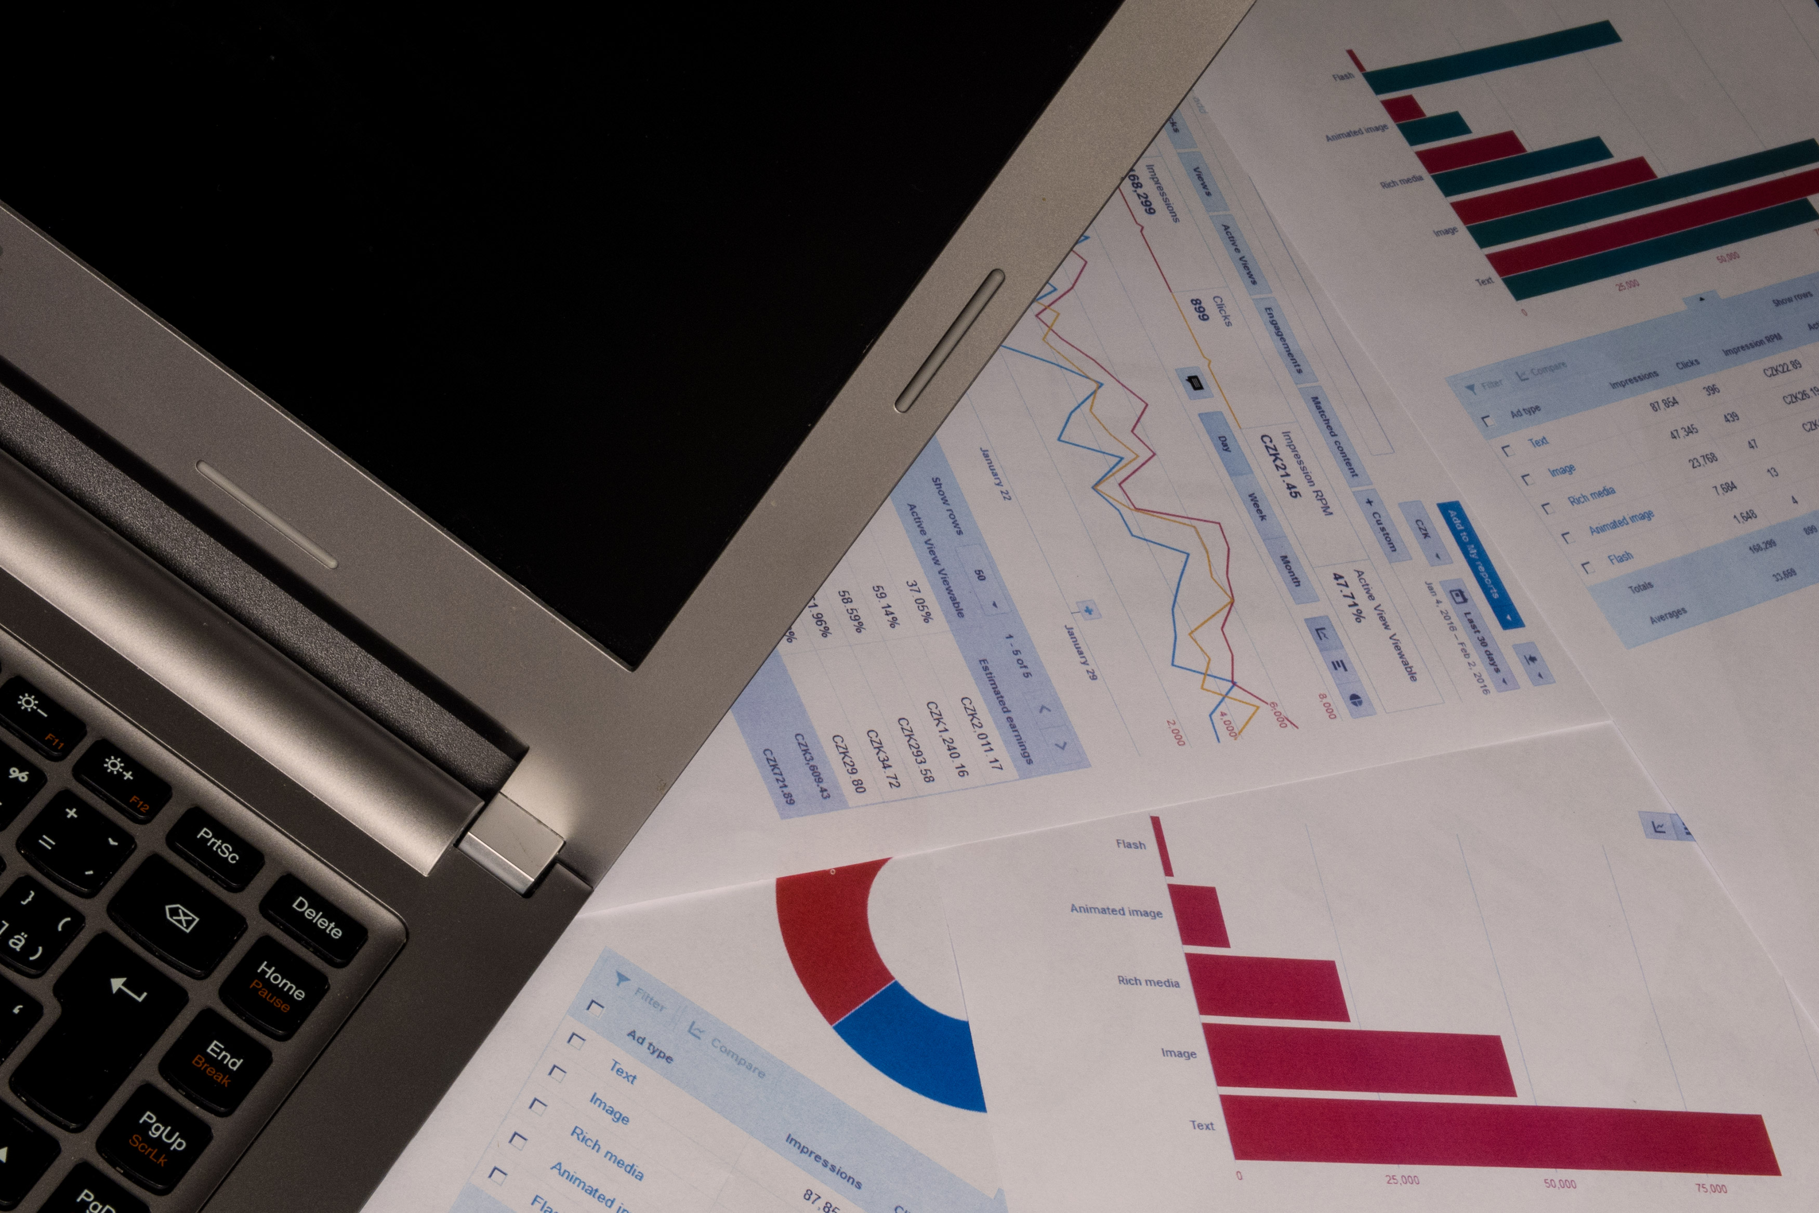


Learnings from project
Incorpated data analysis techniques spealizing in time series analaysis, to deliver valuable insights, accurate sales forecasting & interactive dashboard creation for driving business success.

Slide 13

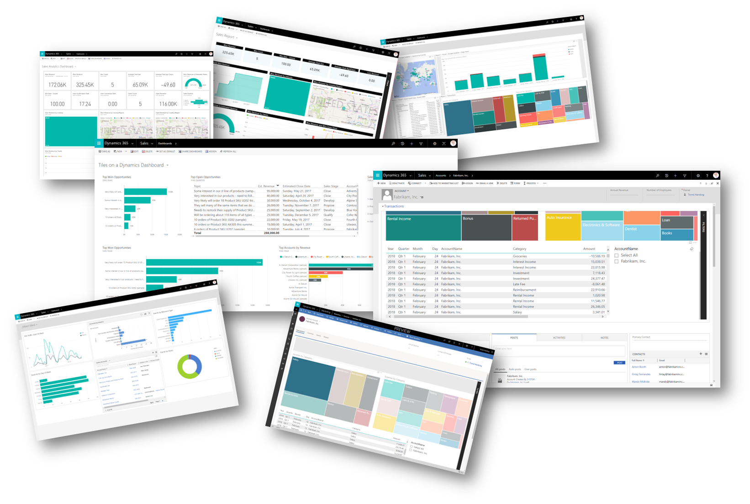
THANK YOU
Presenter Name: Siddhi Tarmale
Email: siddhitarmale20@gmail.com
LinkedIn:https://www.linkedin.com/in/siddhi-tarmale-34b53a253
Github:

